Slide 1
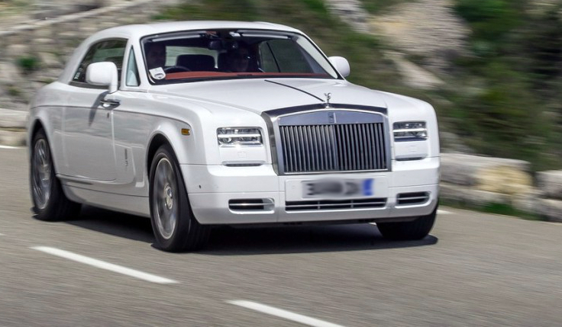

LUXURY CARS DATA ANALYSIS USING JUPYTER NOTEBOOK
“
Isha Madan (Data Analytics Traniee )
IPCS GLOBAL RAIPUR

Slide 2
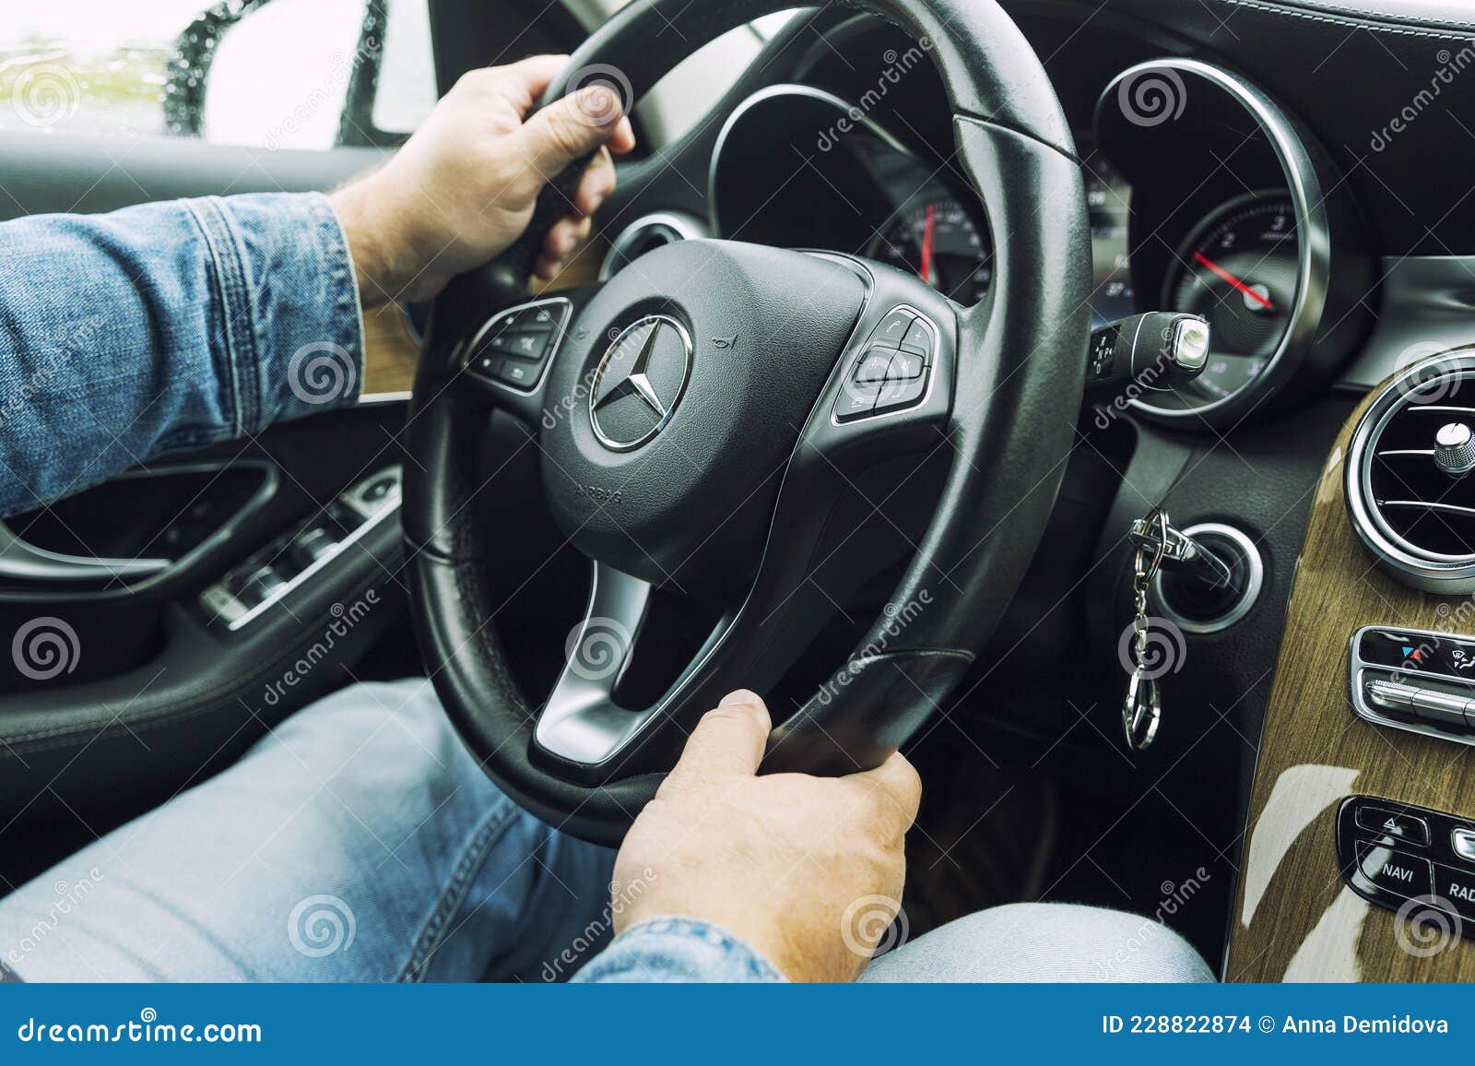
PROJECT OBJECTIVE Objective and Dataset overview content
OBJECTIVE: The objective of this dataset is to analyze car features and pricing to understand factors influencing vehicle performance and market value.
DATA SET: This dataset contains detailed information about various car models, including their specifications, performance, and prices.
GOAL: The goal of this dataset is to explore and understand how different car attributes affect their performance, efficiency, and price.

Slide 3
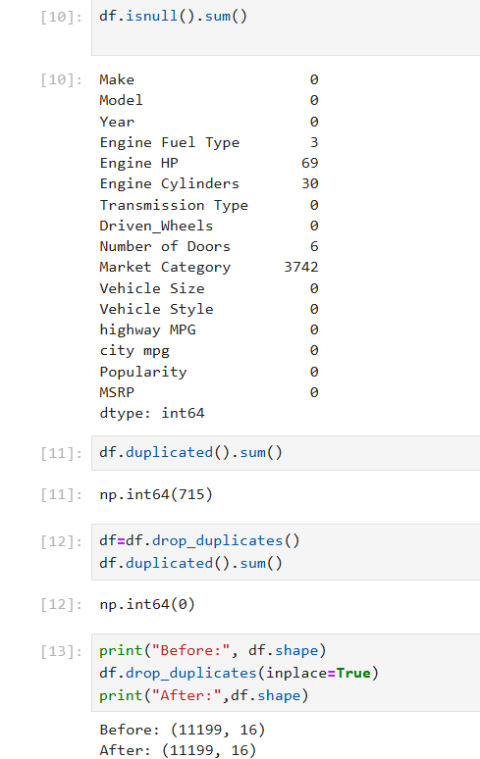
DATA CLEANING AND PREPARATION
Checked for missing values in each column using df.isnull().sum().
Found missing data in Engine Fuel Type (3), Engine HP (69), Engine Cylinders (30), Number of Doors (6), and Market Category (3742).
Identified 715 duplicate rows in the dataset using df.duplicated().sum().
Removed all duplicate records with df.drop_duplicates(inplace=True) to improve data quality.
Verified that duplicates were successfully removed (count became 0).
Confirmed the dataset shape changed from (11,914, 16) to (11,199, 16) after cleaning.

Slide 4
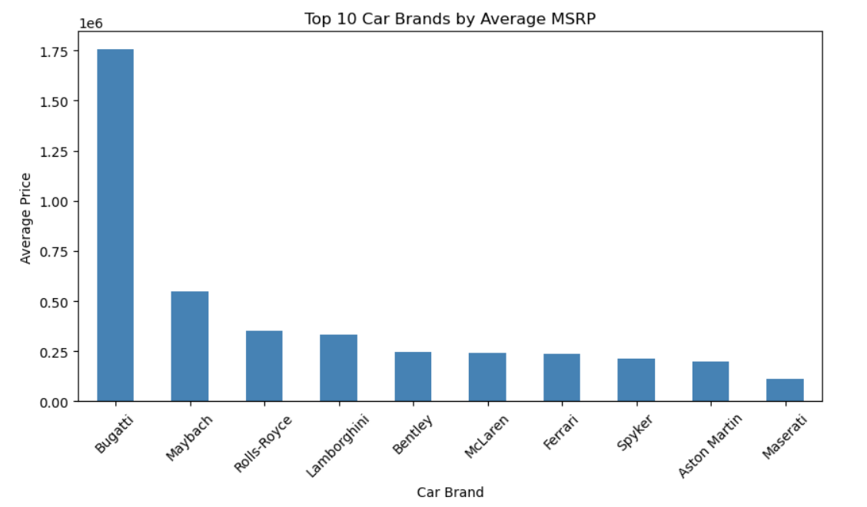
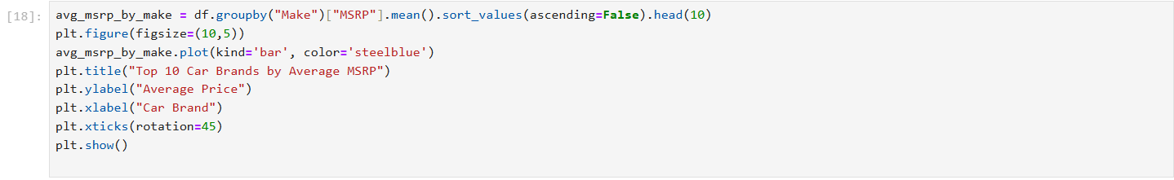
ANALYSIS WITH VISUALS AND INSIGHTS
1.Distribution of Car Prices (MSRP)
Graph: Histogram (or KDE plot)
Shows how car prices are distributed — helps identify whether most cars are affordable, mid-range, or luxury.
Insight:
Most cars have a moderate price range.
Only a few cars are extremely expensive (luxury cars).

Slide 5
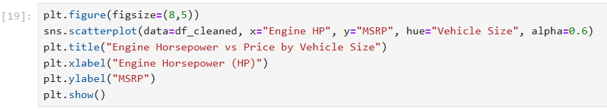
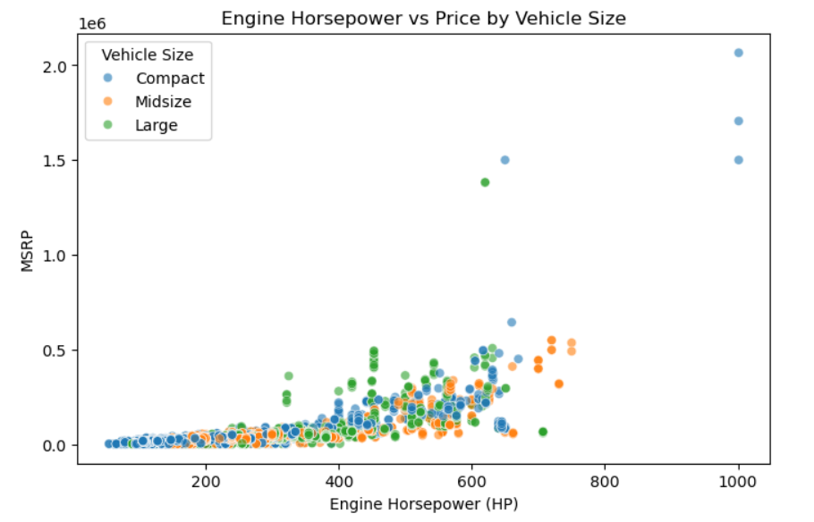
2. Average Horsepower by Car Brand Graph: Scatter Plot Shows which brands produce cars with higher average horsepower (performance). Insight: Luxury and performance brands like BMW, Mercedes, and Porsche generally have higher horsepower. Economy brands like Toyota and Honda have lower horsepower.

Slide 6
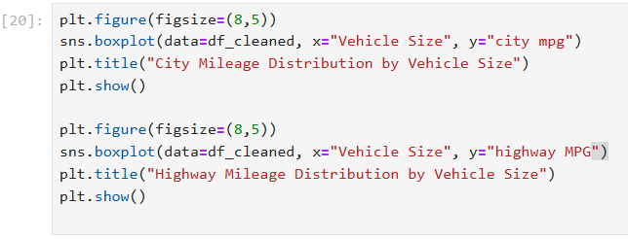
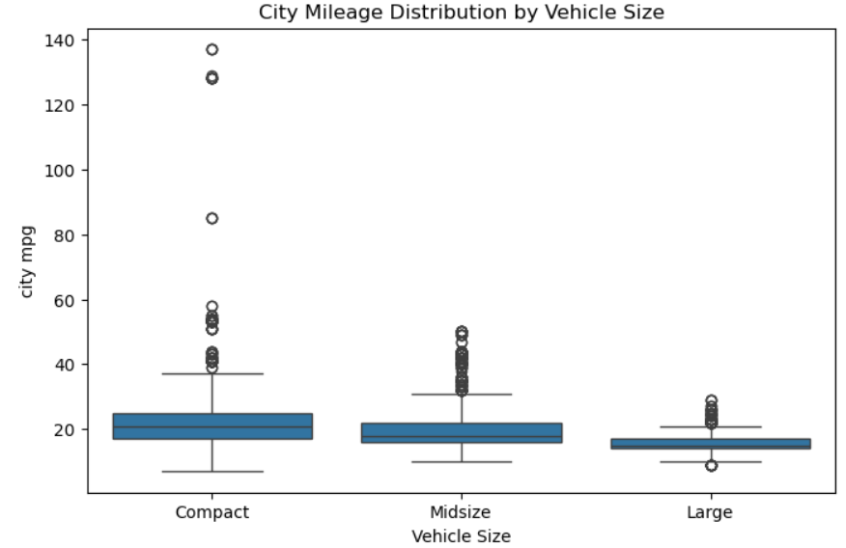
3. City Mileage Distribution by Vehicle Size
Compact cars show the highest city mileage, making them the most fuel-efficient
Midsize cars have moderate mileage, while large cars have the lowest due to bigger engines and weight.
A few outliers represent hybrid or electric cars with very high mpg.

Slide 7
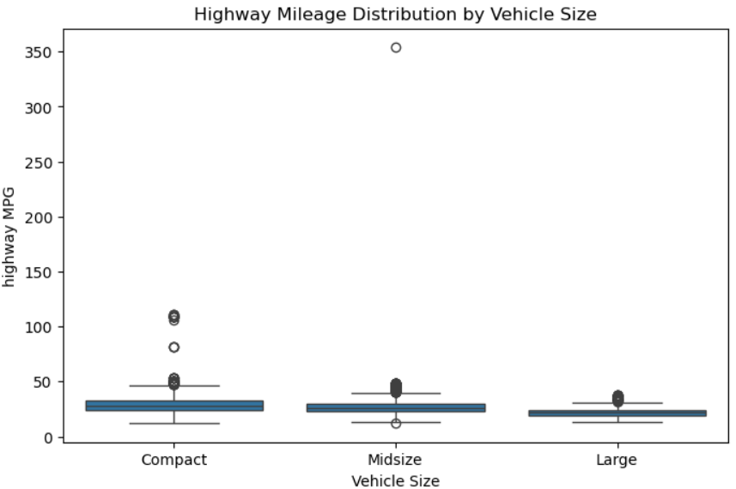
4.Highway Mileage by Vehicle Size
Compact cars again have the best highway mileage, followed by midsize and large vehicles.
Larger cars consume more fuel even on highways.
Outliers indicate high-efficiency models with exceptional performance.

Slide 8
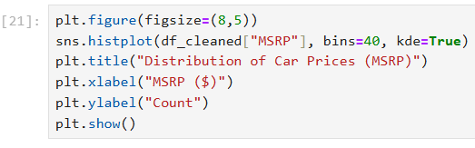
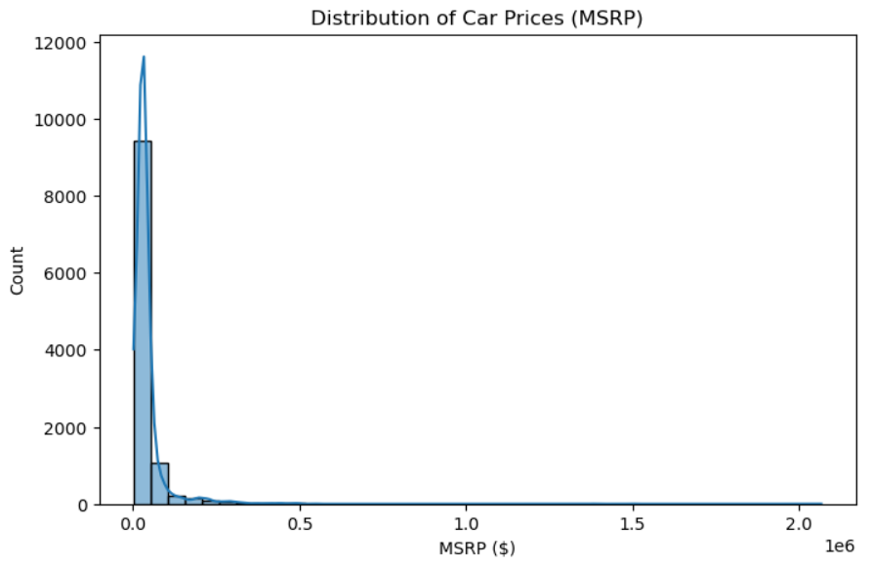
5.Distribution of Car Prices (MSRP)
This histogram shows how car prices are distributed in the dataset.
Most cars fall within the lower to mid-price range, while only a few are very expensive luxury vehicles (right side of the graph).
The right-skewed shape means high-priced cars are less common.
The KDE curve (smooth line) highlights the overall price trend, showing that affordable cars dominate the market.
“

Slide 9
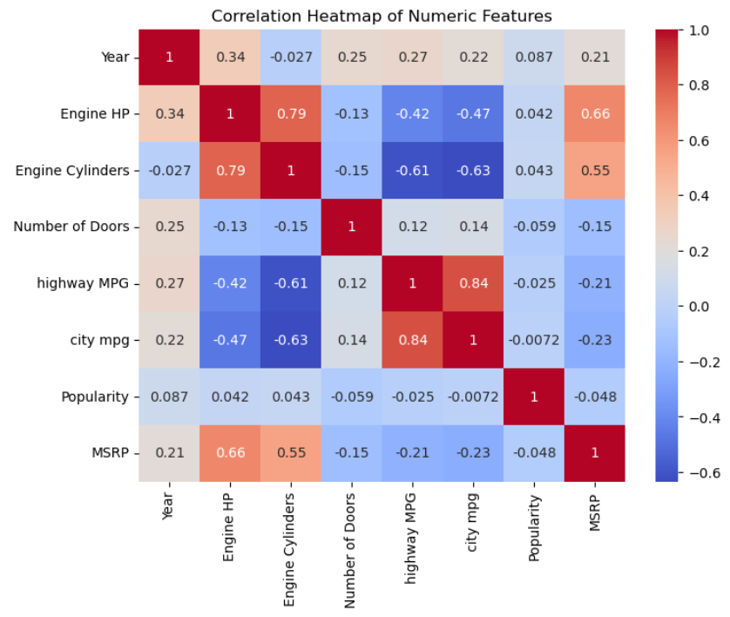
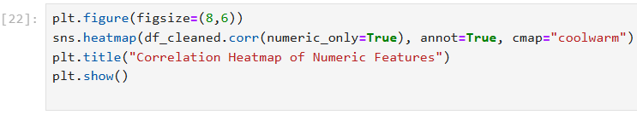
6.Correlation Heatmap of Numeric Features This heatmap shows how different numeric features are related to each other. MSRP has a strong positive correlation with Engine HP and Engine Cylinders, meaning higher power leads to higher price. Fuel efficiency (city & highway MPG) shows a negative correlation with Engine HP and MSRP, as powerful cars consume more fuel. Overall, it highlights clear links between engine performance, fuel economy, and price.

Slide 10
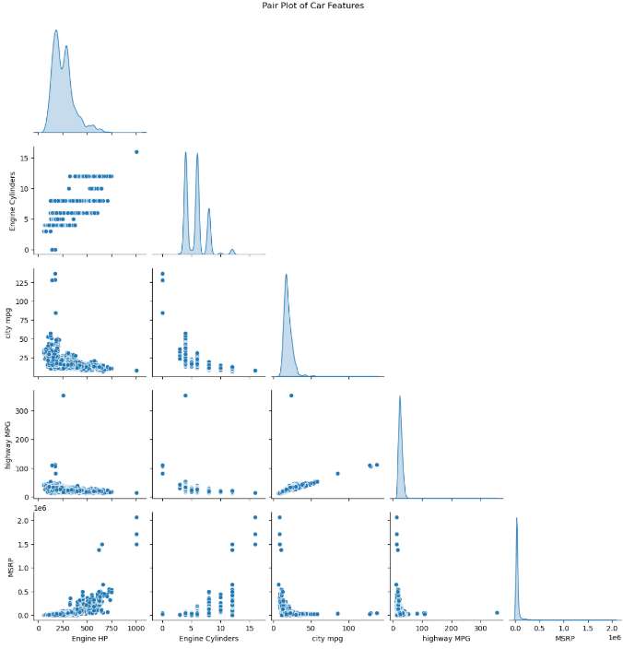
Pair Plot of Car Features
This pair plot shows relationships between key numeric features like engine power, fuel efficiency, and price.
MSRP increases with Engine HP and Cylinders, meaning powerful cars cost more.
City and highway MPG are positively related, and both decrease as horsepower increases.
Overall, it clearly shows the trade-off between performance and fuel efficiency in cars.

Slide 11
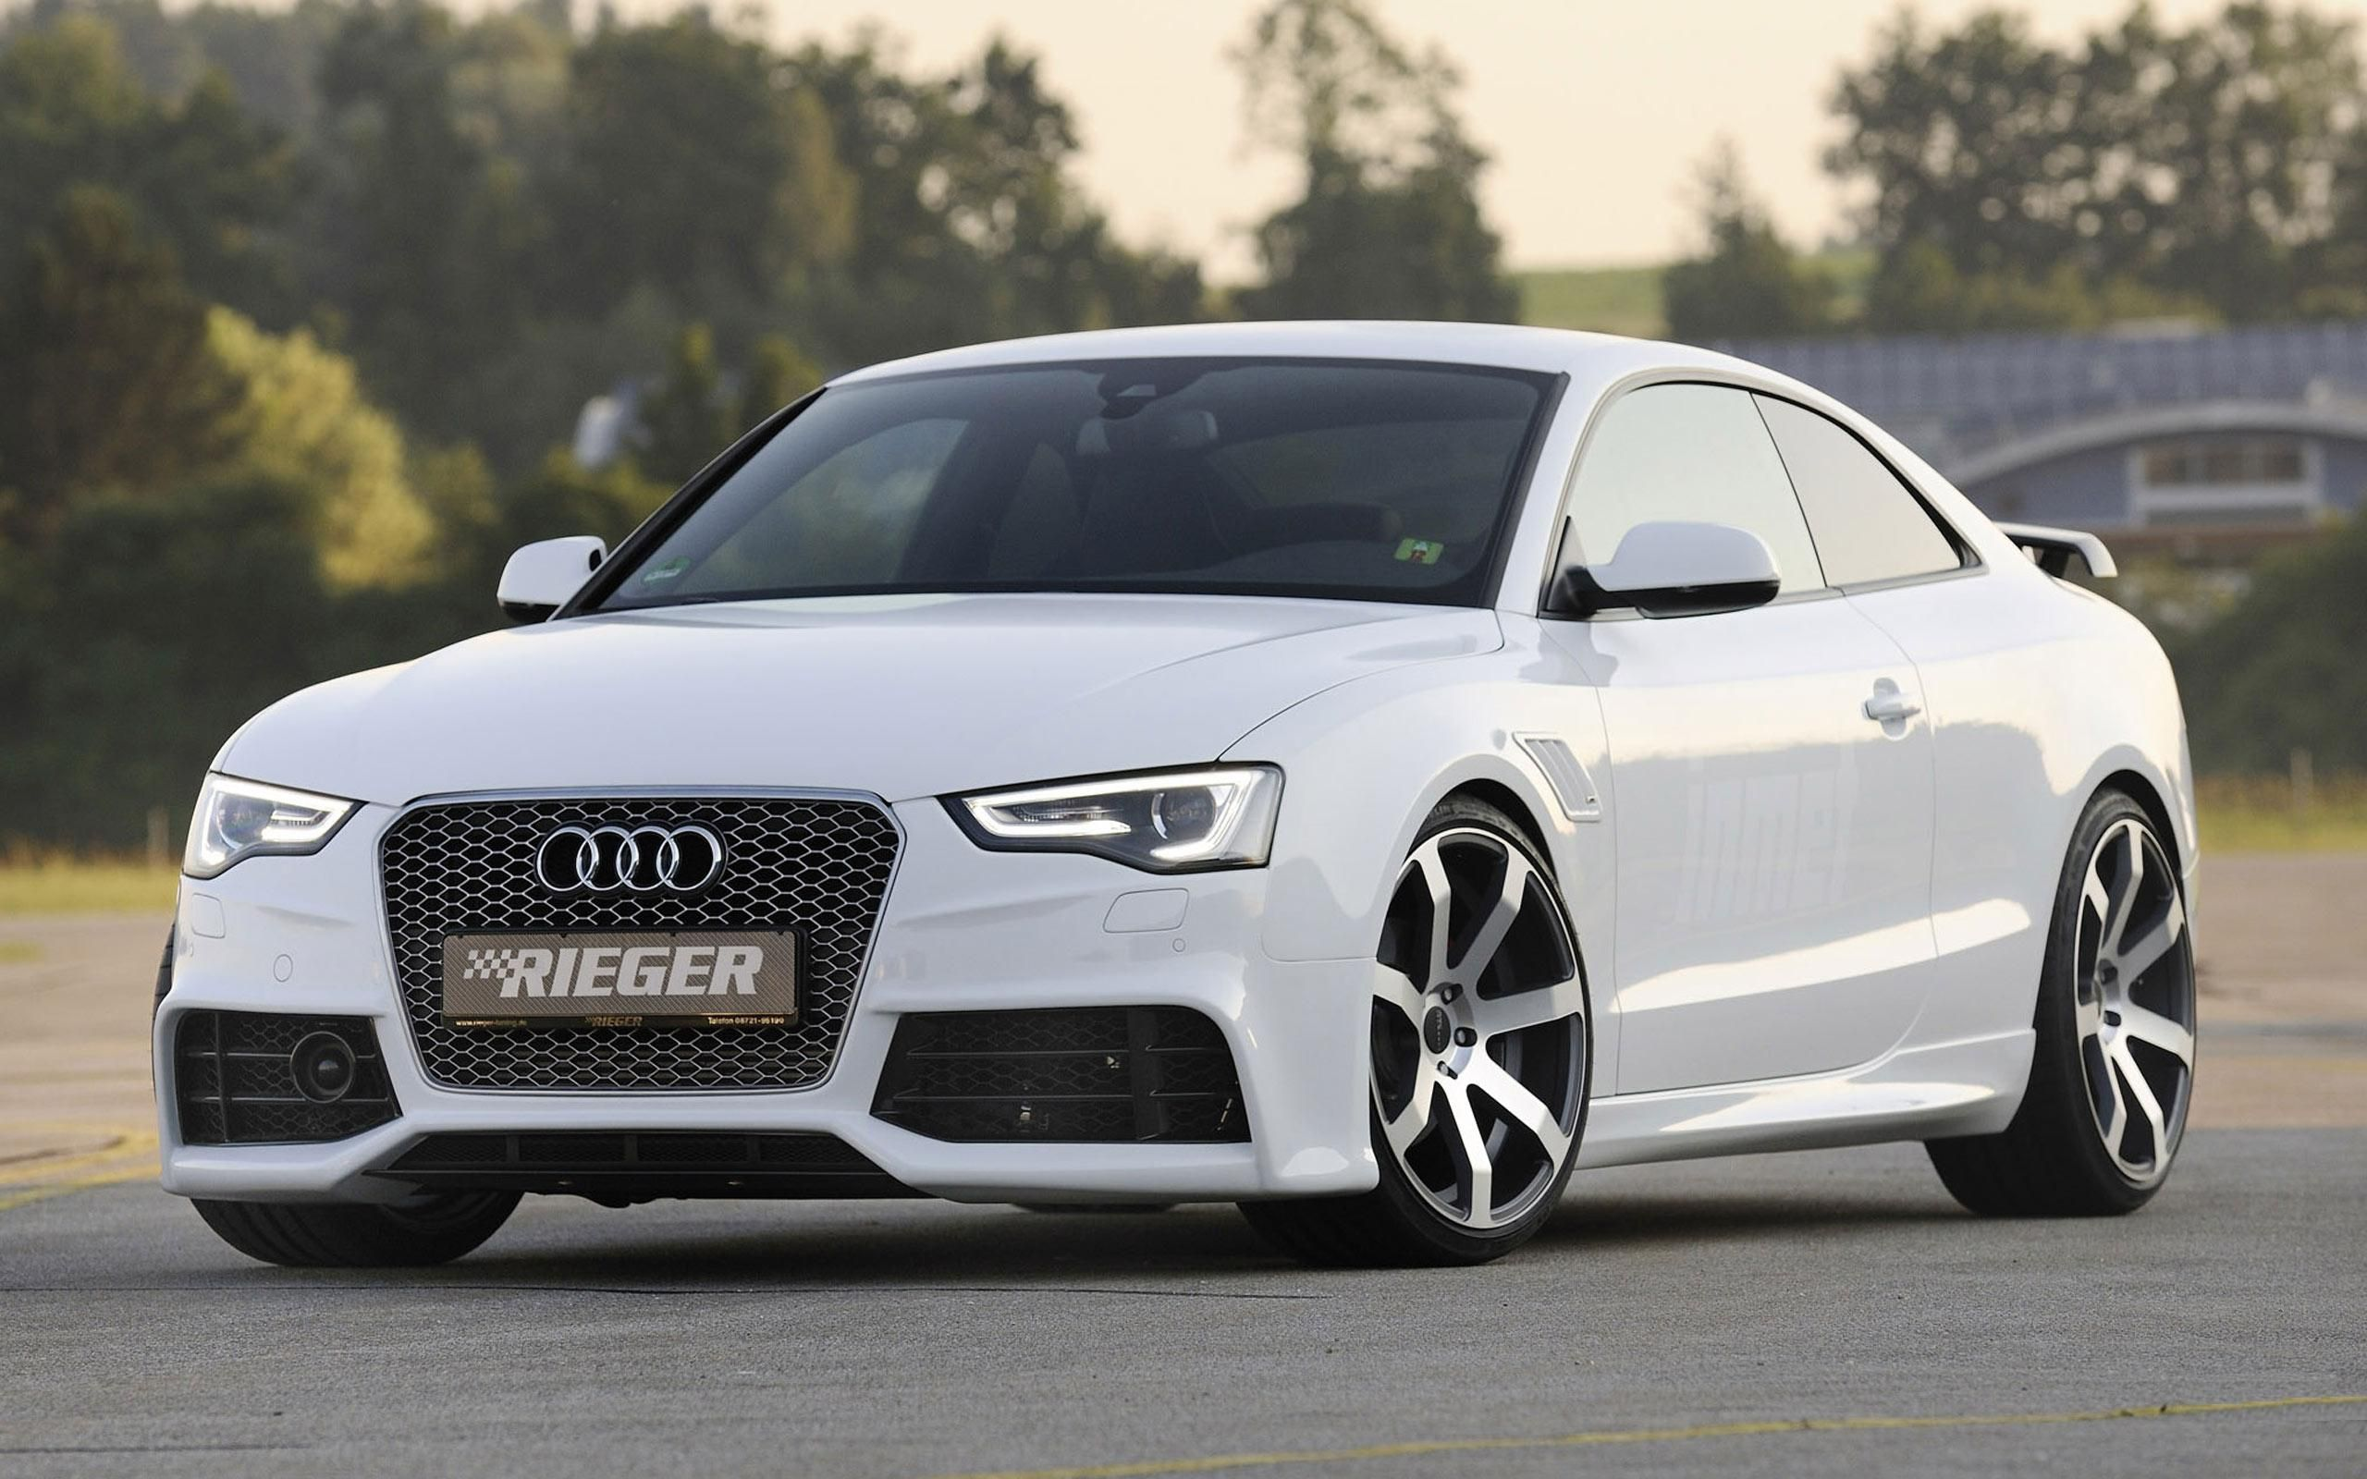
Conclusion This car dataset provides a detailed view of the automotive market, covering 11,199 vehicles with information on price, engine performance, fuel efficiency, and design features. The analysis reveals that engine power (horsepower and cylinders) is a key factor influencing price (MSRP) — powerful cars are more expensive but less fuel-efficient. Compact cars offer better fuel efficiency, making them ideal for cost-conscious buyers, while larger vehicles deliver higher performance and luxury at the cost of mileage. Most cars use automatic transmission, showing a strong consumer preference for convenience. After cleaning and refining the data, clear patterns emerged through visualizations — highlighting the trade-off between performance, efficiency, and cost. Overall, this dataset provides valuable insights into how vehicle specifications impact market value and buyer preferences, forming a solid base for further predictive and market trend analysis.

Slide 12
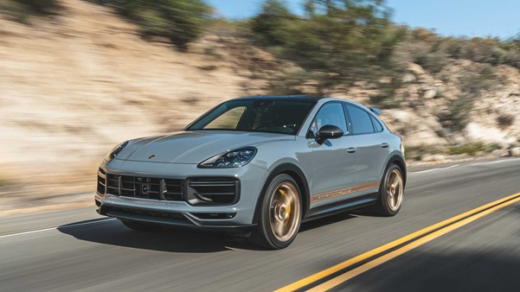
Key Takeaway
Engine Power and Price: Cars with higher horsepower and more cylinders tend to have a significantly higher MSRP, indicating that performance and luxury come at a premium.
Fuel Efficiency Trade-off: There is a clear inverse relationship between engine power and fuel efficiency — as horsepower increases, both city and highway mileage (MPG) decrease.
Vehicle Size Impact: Compact cars are the most fuel-efficient, making them popular among economy-focused buyers, while large vehicles are more powerful but less efficient.
Transmission Trends: The majority of cars use automatic transmission, showing that convenience and ease of driving are top priorities for most consumers.
Market Insights: The dataset covers a wide range of car models from different manufacturers, allowing comparisons across brands, sizes, and performance levels.
Data Quality: After cleaning (removing duplicates and handling missing values), the dataset became more accurate and consistent, ready for deeper analysis.
Correlation Findings: Strong positive correlations exist between engine specifications and price, while negative correlations are seen between engine power and mileage.
Overall Insight: The data highlights the automotive market’s balance between performance, efficiency, and affordability, reflecting diverse consumer preferences and design priorities.

Slide 13
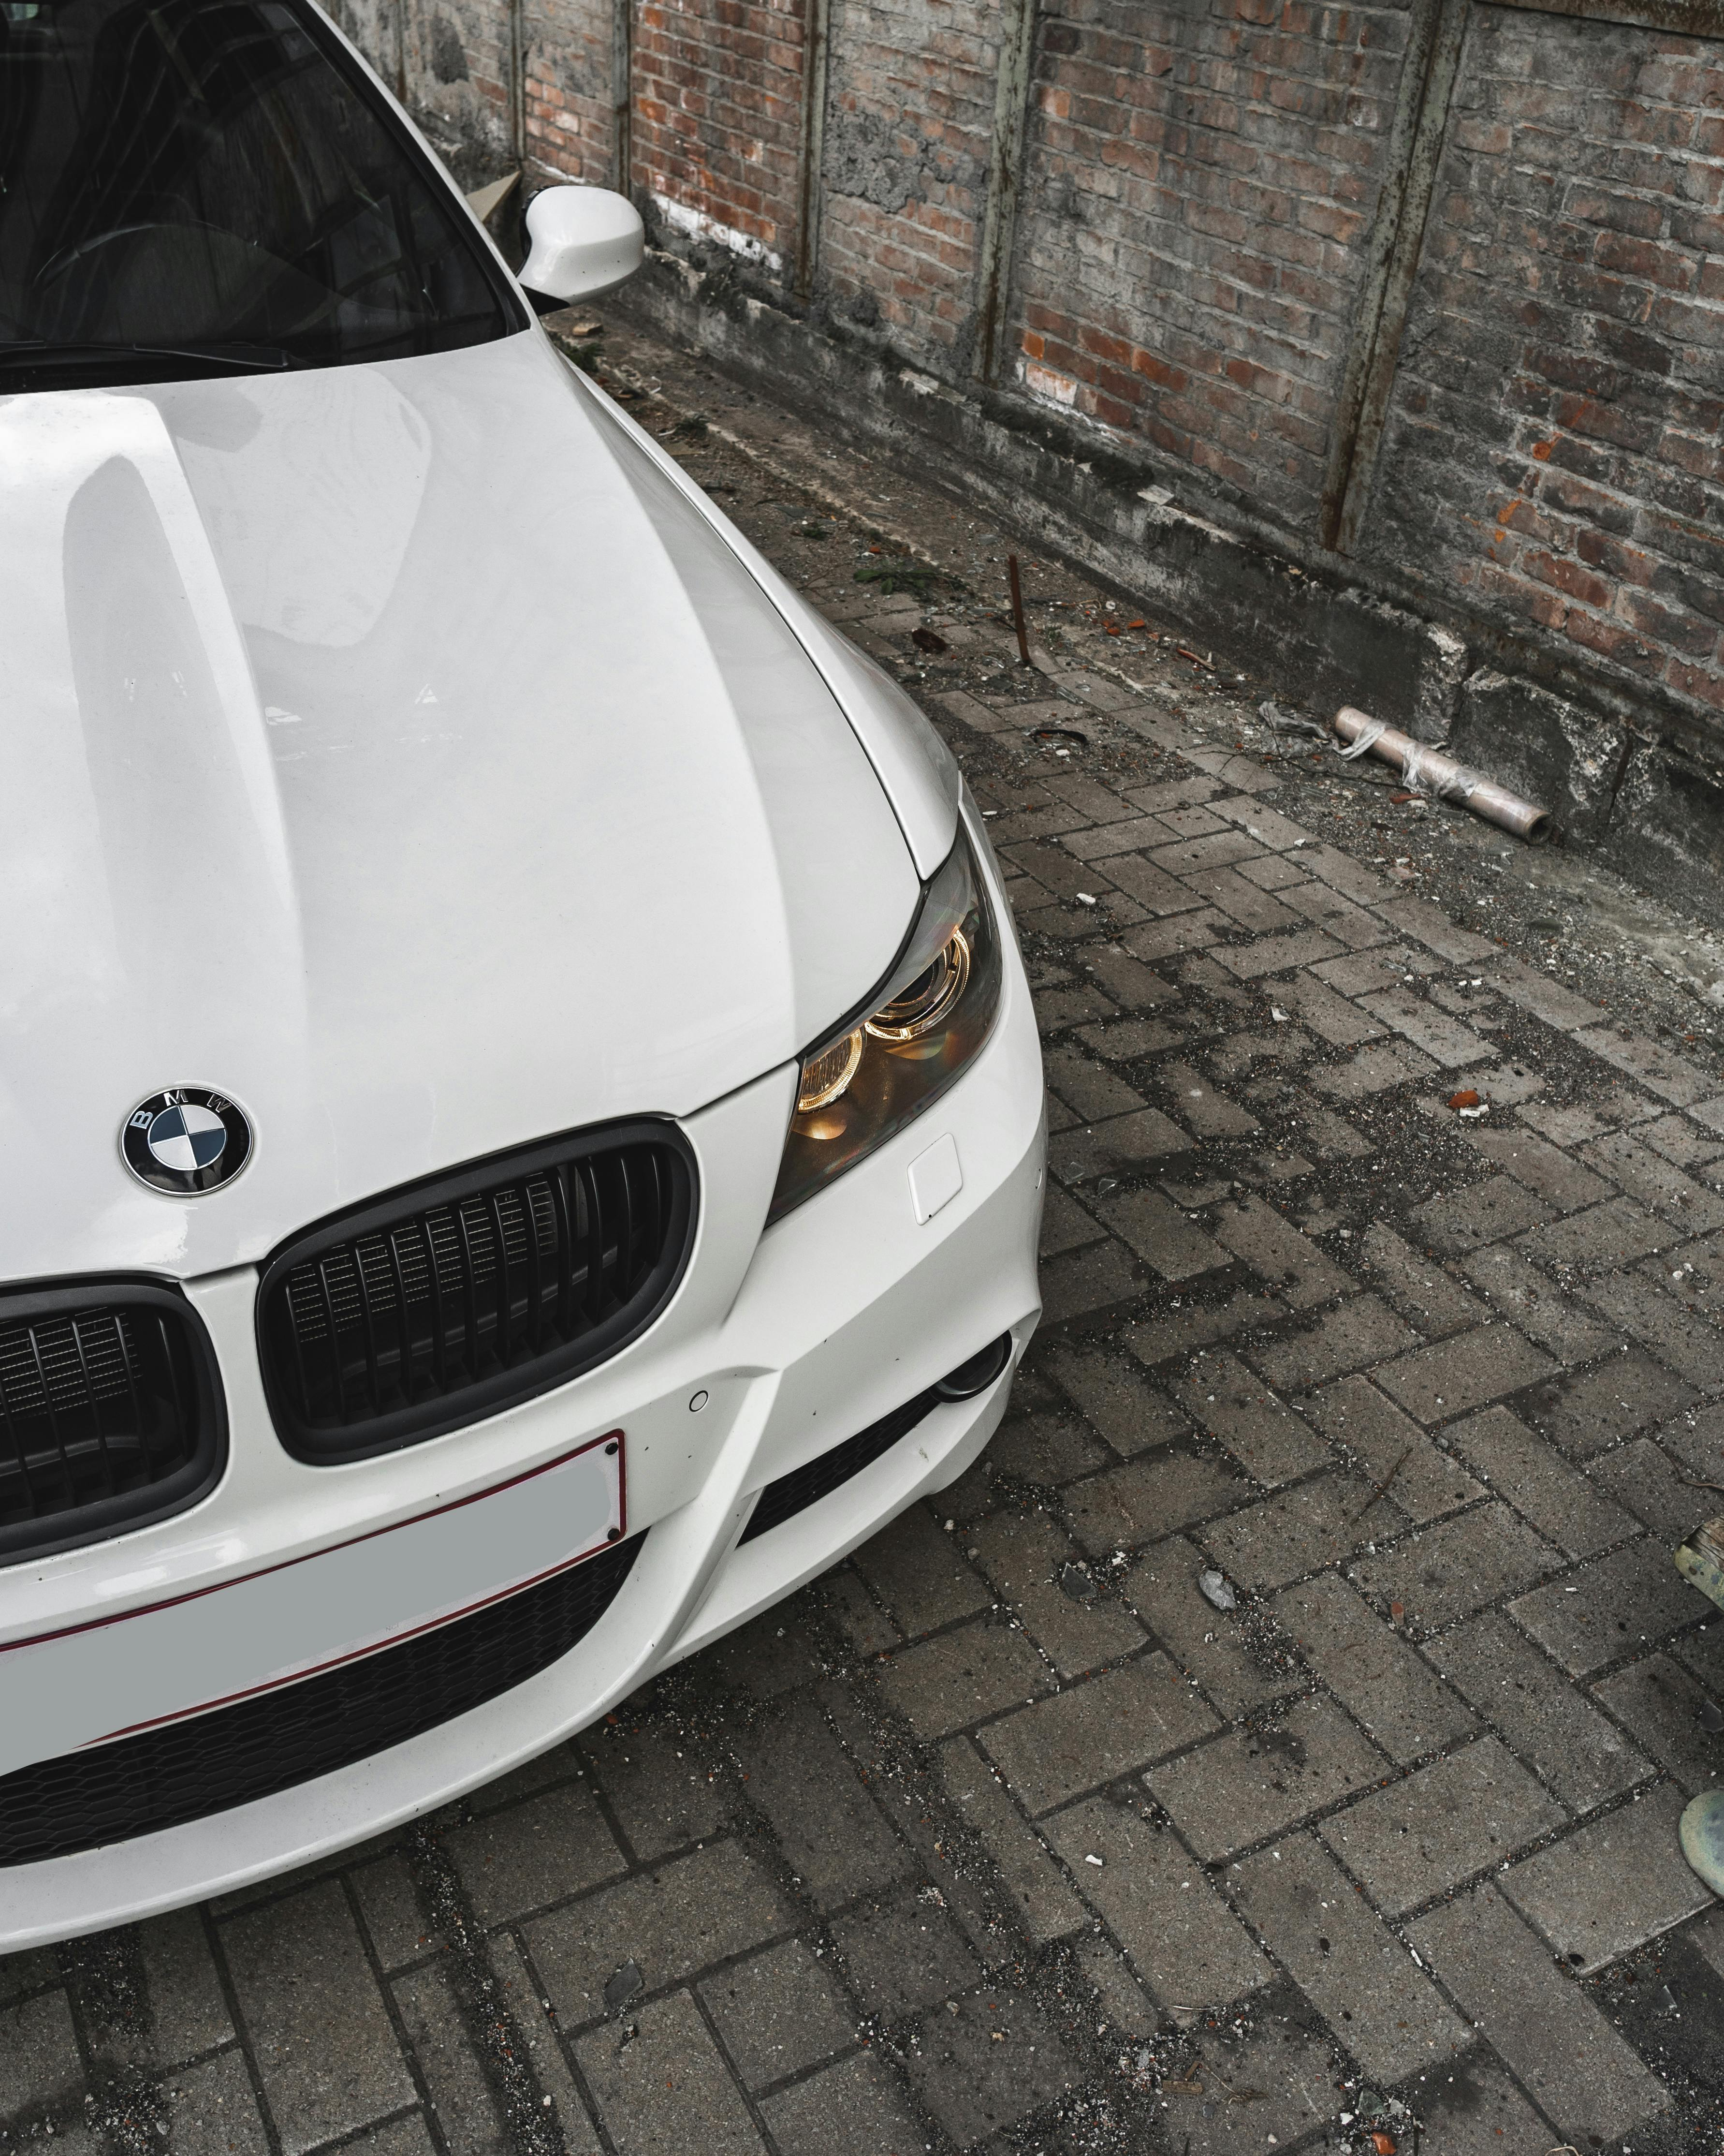
THANKS!

